Slide 1
From Spaghetti to Lasagna Open Source Tools for Transparent, Collaborative, and Reproducible Research
Nick Mader, PhD
Senior Researcher, Chapin Hall at the University of Chicago Visiting Scholar, BU

Slide 2
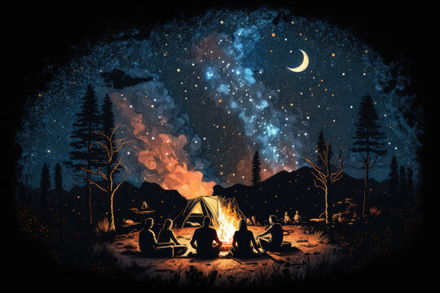

horror stories
Reproducible research
Image by brgfx

Slide 3
horror stories
Reproducible research
Image by brgfx

Slide 4
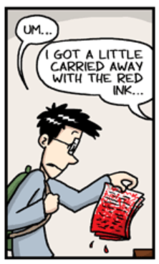
Transparency
https://phdcomics.com/comics/archive.php?comicid=690
Notes:
Story from Dick: student was writing dissertation, very advanced stage, offered a new ideas, results didn't make sense, prof asked to look at code, realized everything was wrong

Slide 5
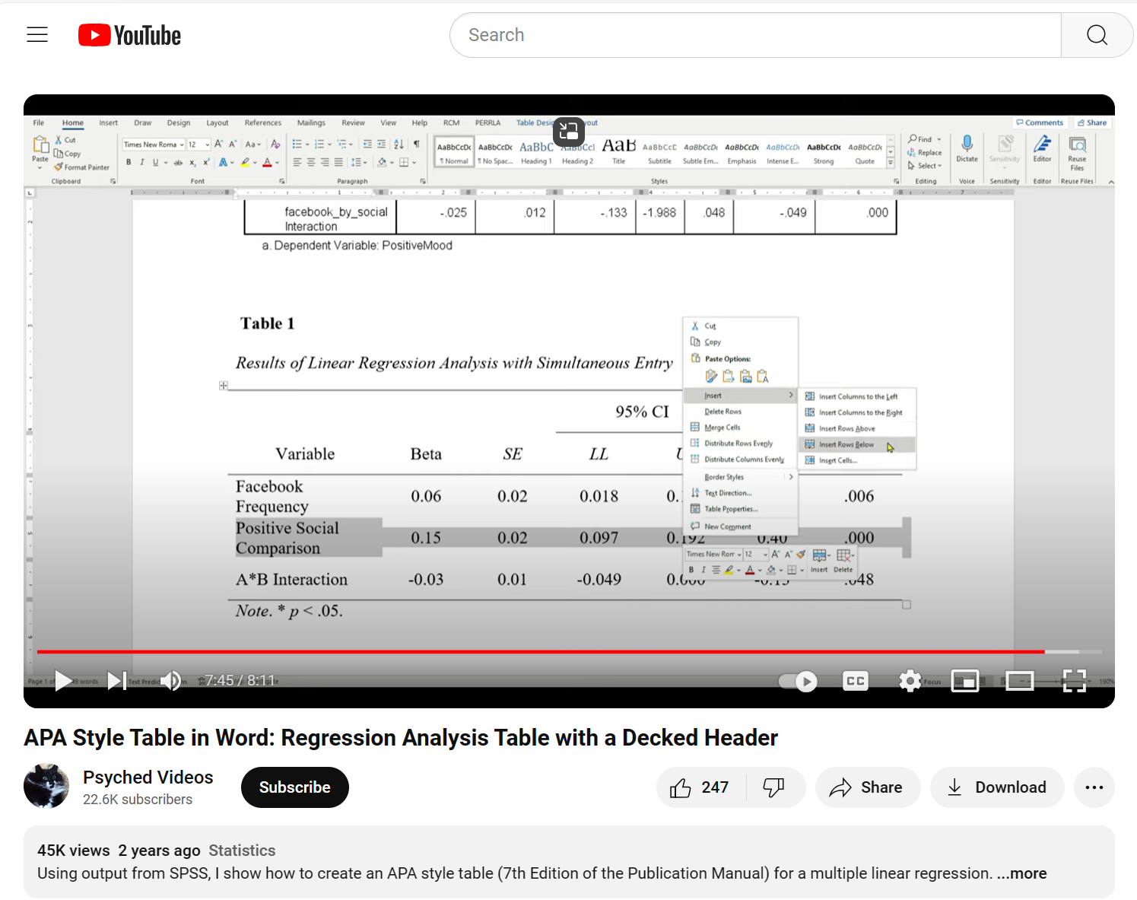
Efficiency/Accuracy
Notes:
Colleague was building tables in Word, more data was received which would update all of the numbers, and they had to take the day off

Slide 6
Efficiency
https://www.youtube.com/watch?v=jlxrofQdaZQ&t=463s
Notes:
Colleague was building tables in Word, more data was received which would update all of the numbers, and they had to take the day off

Slide 7
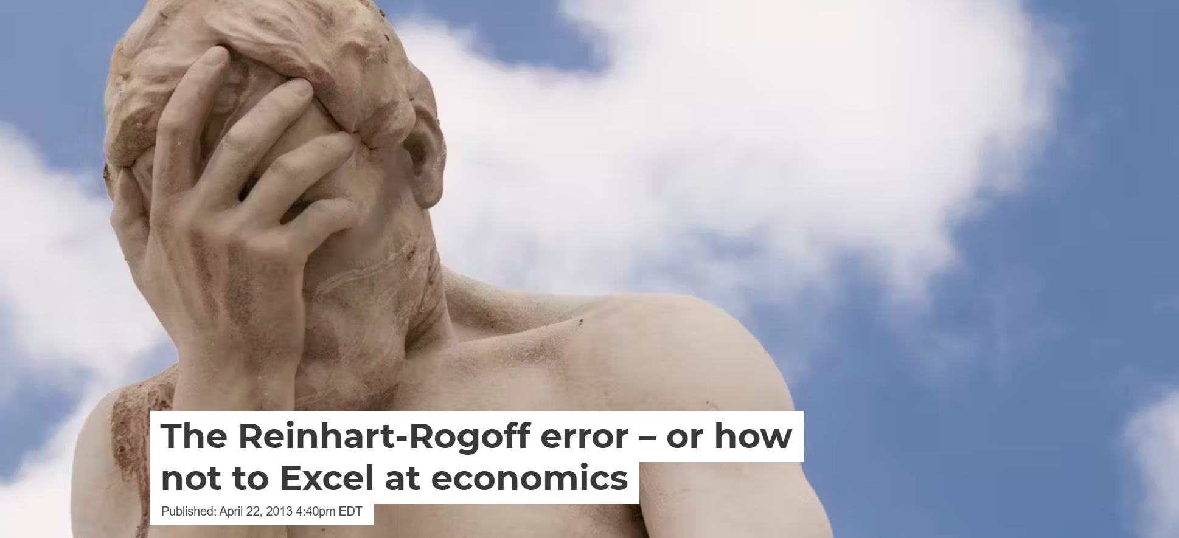
Replicability
https://theconversation.com/the-reinhart-rogoff-error-or-how-not-to-excel-at-economics-13646
Notes:
Story about the sovereign debt and Excel

Slide 8
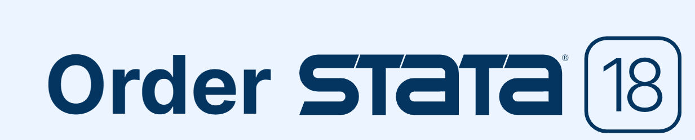
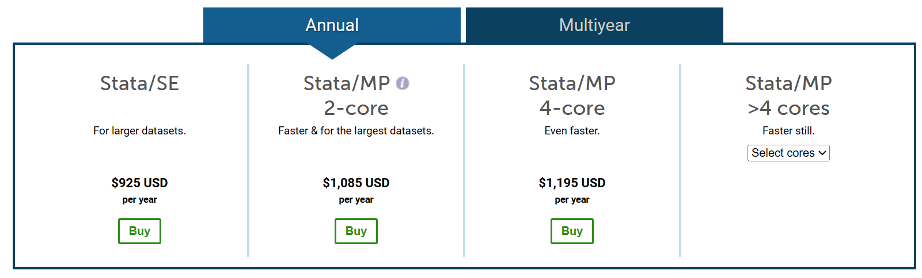
Open Source
https://www.stata.com/order/new/gov/single-user-licenses/dl/
Notes:
Story about former Harris students going to work for non-profit that couldn't afford stata or SAS

Slide 9
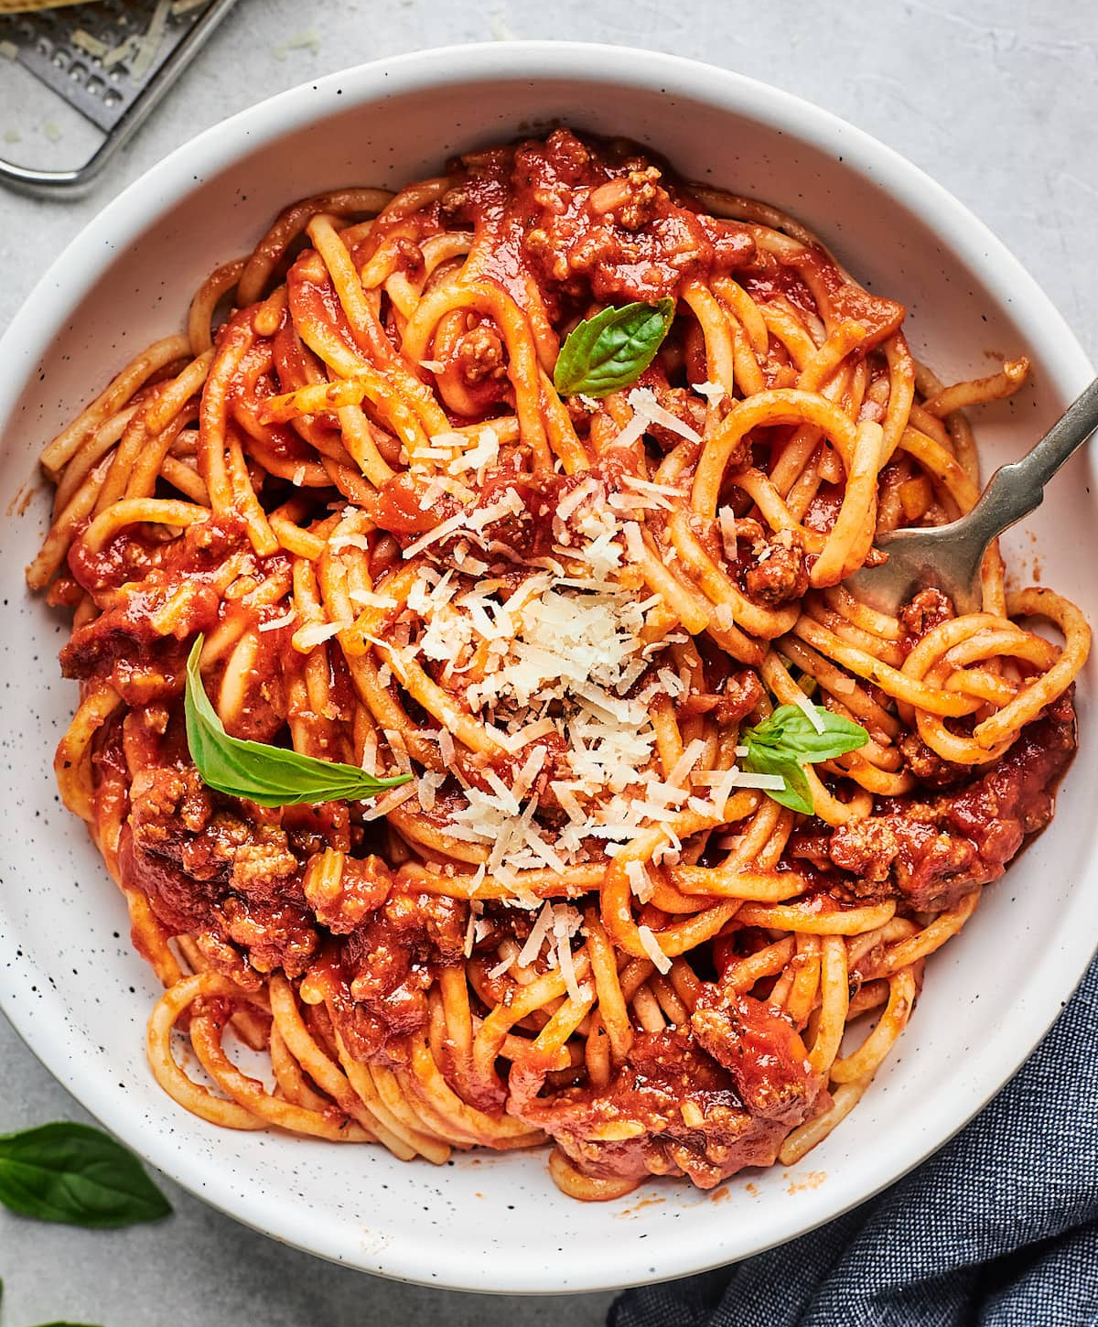
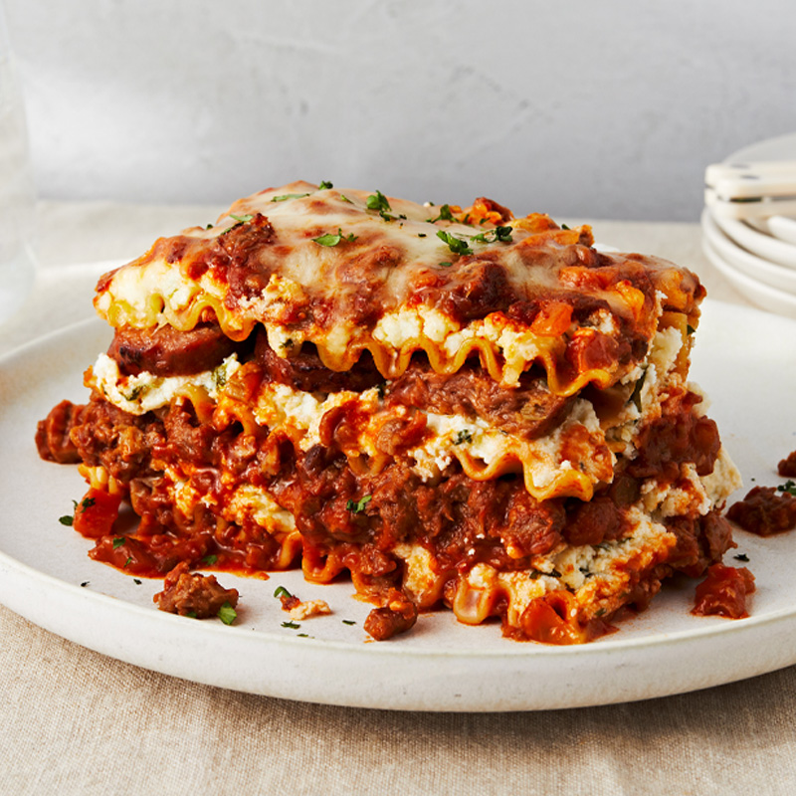
https://www.twopeasandtheirpod.com/spaghetti/
https://www.beyondmeat.com/en-US/recipes/beyond-beef-and-hot-italian-lasagna

Slide 10



Familiar? 👍🏼?👎🏼?
Some free and open source tools

Slide 11
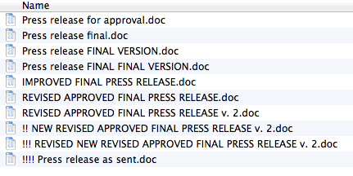
https://properdiscord.com/2012/09/13/never-use-the-word-final-in-a-filename/

Slide 12
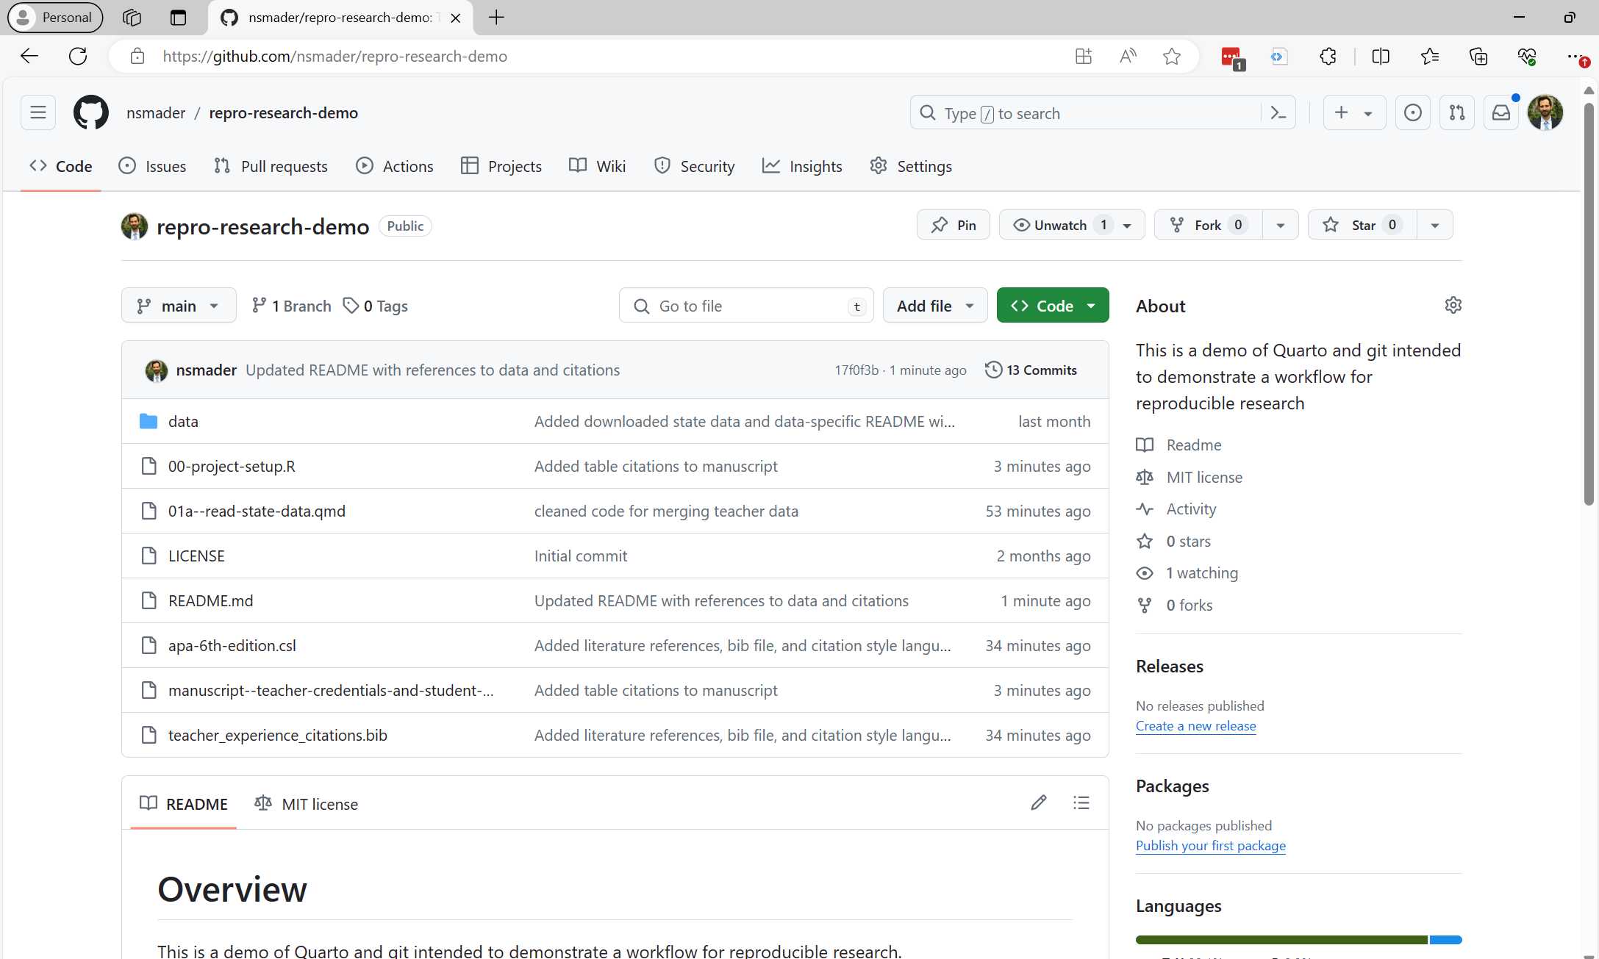

Slide 13
Some things to talk about (optional)
Show/tell me more about how to create _____ in R:
Maps
Figures
Tables
Regression
Tell me more about:
R
Quarto
git
Why/how can/should I use version control?
How hard are these things to learn?
Are these tools in common use?
Notes:
Next: slowly go through paper, fix error, slowly go through R and RStudio.

